Slide 1

















HYPOTHESIS TESTING
Finding the Optimal reorder quantities of fresh produce products
Ang Kang Xian
Lee Min Shuen
Samuel Sim
Lynn Lynelle
Muhammad Hazwan
Manufacturing Systems and Operations/Statistics 2D, Term 5, 2021
VALUEGREENS.SG
Notes:
https://unsplash.com/photos/AXu2aZ3YgP8

Slide 2

COMPANY

Slide 3
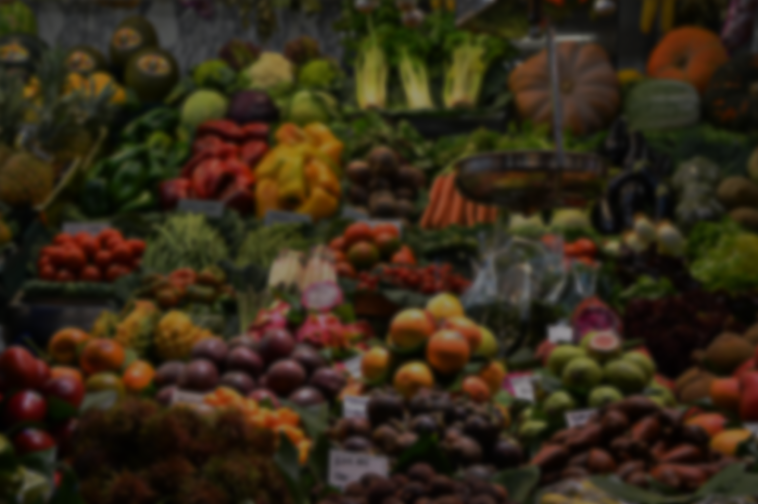
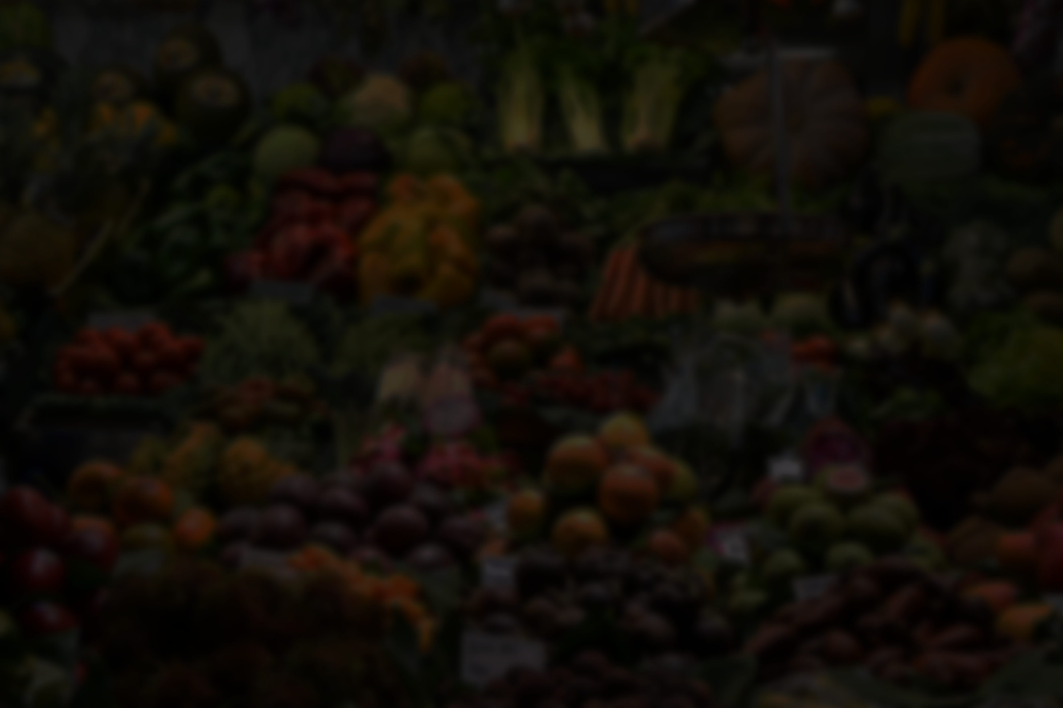
VALUEGREENS.SG
COMPANY
Value Greens is known for handling fresh produce by manually handpicking fresh produce for sale on the same day.
Task: To use a data-driven approach to determine the best inventory model to order their vegetables for their shop based on data for their vegetable demand to maximize profits.
Notes:
https://unsplash.com/photos/fItRJ7AHak8

Slide 4

METHODOLOGY

Slide 5
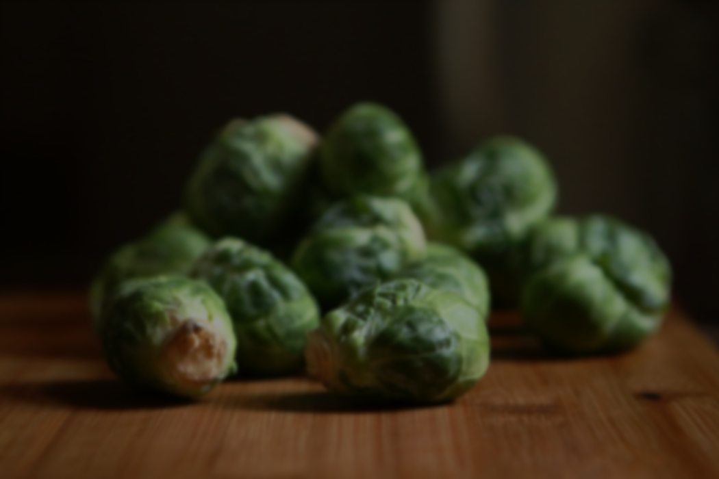

METHODOLOGY
Tidy the data into number of vegetables sold daily.
2. Cluster the vegetables into packets and grams.
3. Ascertain the demand distributions of chosen vegetables using statistics tools.
4. Apply the Newsvendor and (Q,r) Model to determine optimal daily quantities.
5. Compare performance of Models with regards to profit.
VALUEGREENS.SG
Notes:
https://unsplash.com/photos/48nerZQCHgo

Slide 6

DATA CLEANING & CLUSTERING

Slide 7





DATA CLEANING & CLUSTERING
The dataset presented to us consists of two main order types:
Regular orders
Promotional orders
VALUEGREENS.SG
Notes:
https://unsplash.com/photos/TvN54bnuQg8

Slide 8

DATA CLEANING & CLUSTERING
Joining of the promotional orders into the individual vegetables
Remove any Chinese characters and pricing from column headings
Combine repeated columns of the same vegetable.
Aggregate daily orders and remove any outliers outside the interquartile range.
VALUEGREENS.SG
Notes:
https://unsplash.com/photos/TvN54bnuQg8

Slide 9
DATA CLEANING & CLUSTERING
Cluster the vegetables based on units of measurements: packets and grams.
Selected the largest mean demand vegetable
Broccoli for the “packets” category and the Potato for the “grams” category.
VALUEGREENS.SG

Slide 10

STATISTICS PLOTS & TESTS

Slide 11
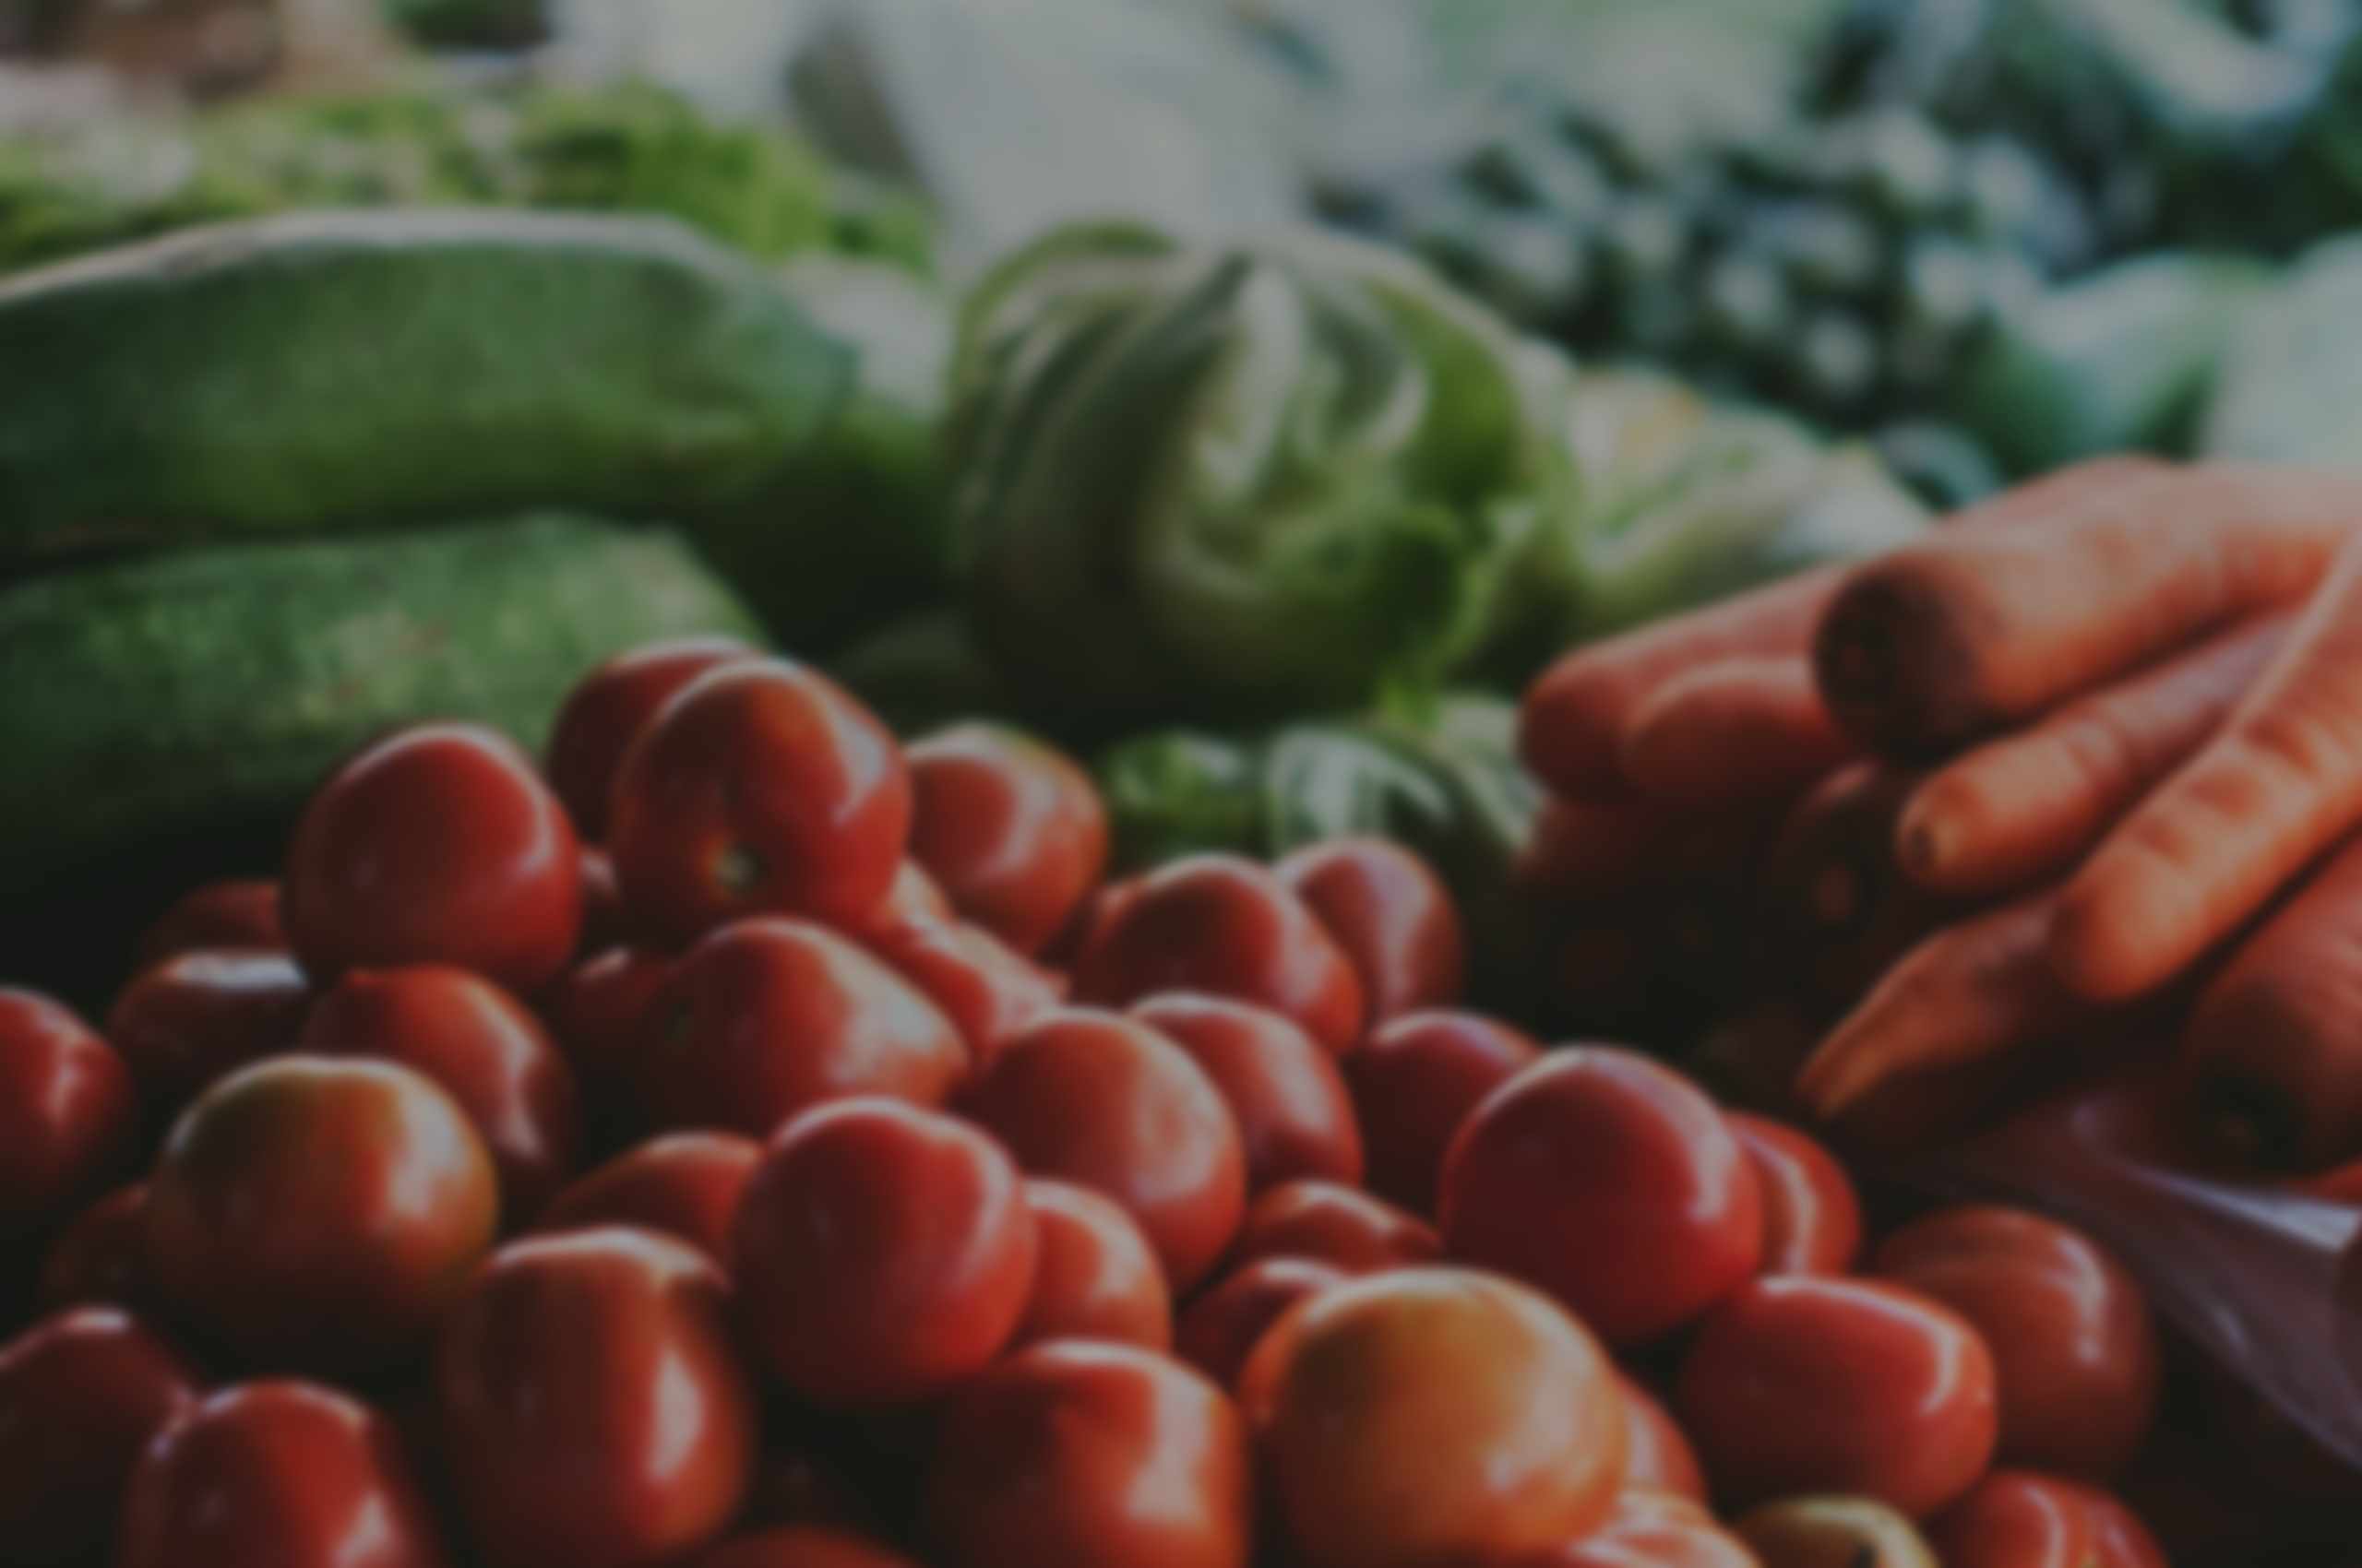

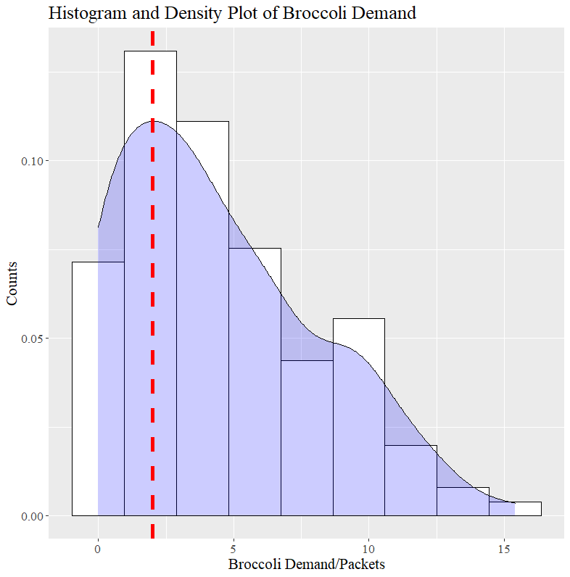
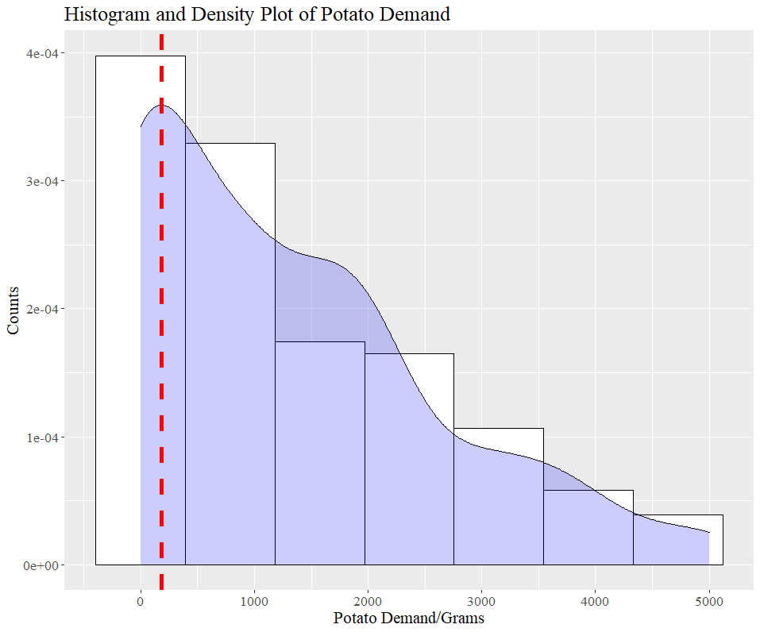
STATISTICS PLOTS & TESTS
Notes:
https://unsplash.com/photos/TvN54bnuQg8

Slide 12
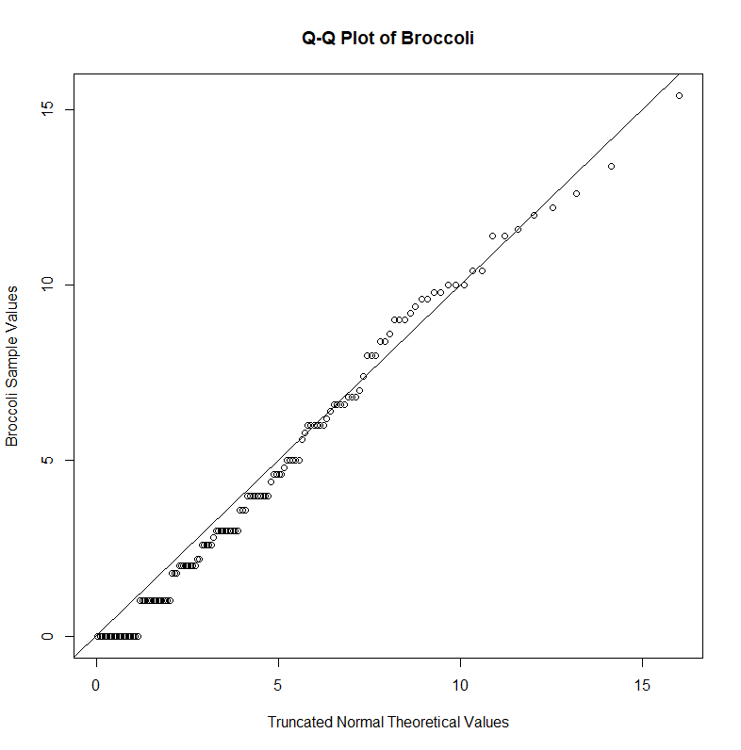
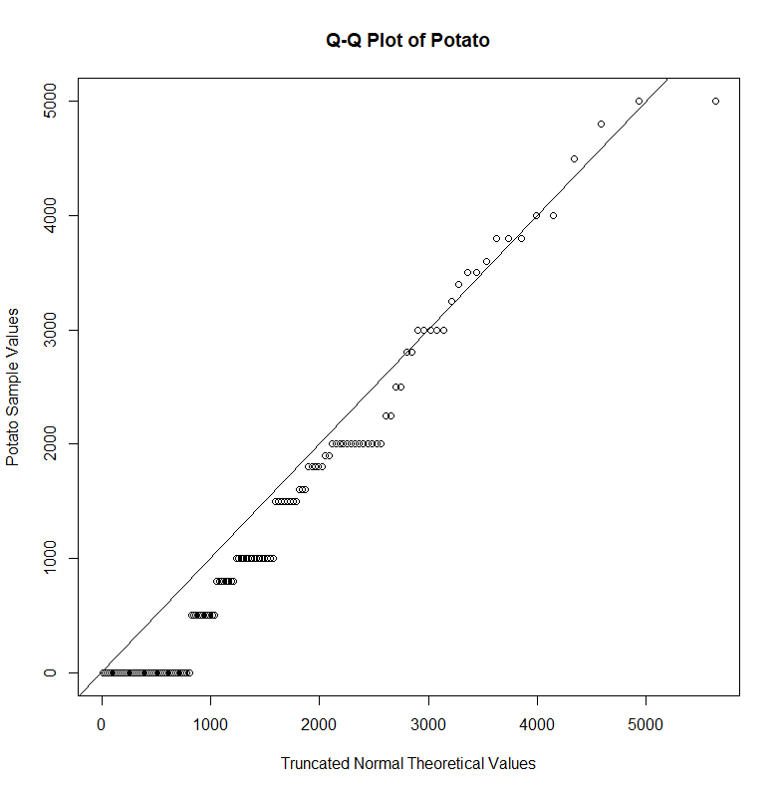
STATISTICS PLOTS & TESTS
Demand of Broccoli ~ Truncated Normal (2,5²,0, ꝏ)
Demand of Potato ~ Truncated Normal (180,1900²,0, ꝏ)
VALUEGREENS.SG
Notes:
https://unsplash.com/photos/TvN54bnuQg8

Slide 13
STATISTICS PLOTS & TESTS
Thicker tails in true underlying distribution
Notes:
https://unsplash.com/photos/TvN54bnuQg8

Slide 14


STATISTICS PLOTS & TESTS
Chi-Square Goodness of Fit Test
H₀ : DD of Broccoli ~ Truncated Normal (2,5²,0, ꝏ)
H₁ : DD of Broccoli does not follow a truncated normal distribution
H₀ : DD of Potato ~ Truncated Normal (180,1900²,0, ꝏ)
H₁ : DD of Potato does not follow a truncated normal distribution
VALUEGREENS.SG
Notes:
https://unsplash.com/photos/TvN54bnuQg8

Slide 15
STATISTICS PLOTS & TESTS
Interval |  | Counts | Expected Probability | Expected Count | Chi^2 Calculation
0 | 1 | 18 | 0.12 | 15.22 | 0.51
1 | 2 | 17 | 0.12 | 15.84 | 0.08
2 | 3 | 16 | 0.12 | 15.84 | 0.00
3 | 4 | 13 | 0.12 | 15.22 | 0.32
4 | 5 | 15 | 0.11 | 14.06 | 0.06
5 | 6 | 7 | 0.10 | 12.47 | 2.40
6 | 7 | 15 | 0.08 | 10.63 | 1.79
7 | 8 | 2 | 0.07 | 8.71 | 5.17
8 | 9 | 6 | 0.05 | 6.86 | 0.11
9 | 10 | 9 | 0.04 | 5.19 | 2.80
10 | 16 | 13 | 0.08 | 10.95 | 0.38
Total Counts | 131
Estimated Mean | 2.00
Estimated SD | 5.00
Degree of Freedom | 8
Significance Alpha | 0.05
Chi^2 | 13.3
Critical Value | 15.5
Broccoli
Chi^2 | 13.3
Critical Value | 15.5
Potato
Chi^2 | 4.8
Critical Value | 6.0
For both tests, the data is consistent with the H₀ at α = 0.05 since the chi-square value < critical value
Interval |  | Counts | Expected Probability | Expected Count | Chi^2 Calculation
0 | 1000 | 60 | 0.381 | 49.871 | 2.057
1000 | 2000 | 33 | 0.305 | 39.944 | 1.207
2000 | 3000 | 19 | 0.186 | 24.405 | 1.197
3000 | 4000 | 13 | 0.087 | 11.374 | 0.232
4000 | 6000 | 6 | 0.041 | 5.405 | 0.065
Total Counts | 131
Estimated Mean | 180
Estimated SD | 1900
Degree of Freedom | 2
Significance Alpha | 0.05
Chi^2 | 4.8
Critical Value | 6.0
Notes:
https://unsplash.com/photos/TvN54bnuQg8

Slide 16

NEWSVENDOR MODEL

Slide 17


NEWSVENDOR MODEL
Determine optimal reorder quantity, Q*.
Trade-off between overage and shortage costs.
Assumptions:
Periodic orders of 1 day (Ensure product freshness).
One time decision to order at the start of the day.
Future periods neglected as leftovers are discarded.
No interactions between vegetables.
VALUEGREENS.SG
Notes:
https://unsplash.com/photos/GKLIsLZxhj0

Slide 18
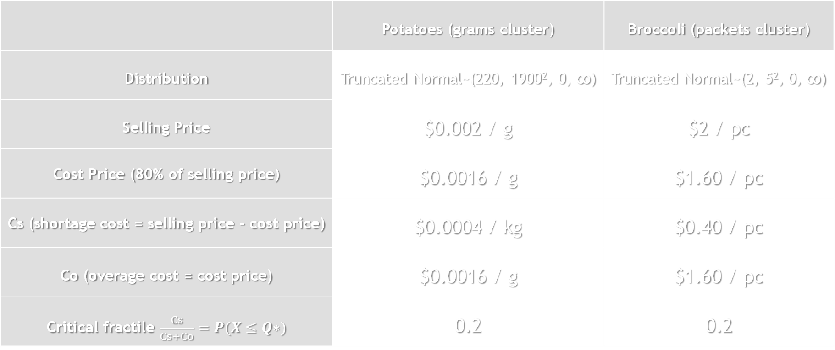
NEWSVENDOR MODEL
 | Potatoes (grams cluster) | Broccoli (packets cluster)
Distribution | Truncated Normal~(220, 1900², 0, ꝏ) | Truncated Normal~(2, 5², 0, ꝏ)
Selling Price | $0.002 / g | $2 / pc
Cost Price (80% of selling price) | $0.0016 / g | $1.60 / pc
Cs (shortage cost = selling price – cost price) | $0.0004 / kg | $0.40 / pc
Co (overage cost = cost price) | $0.0016 / g | $1.60 / pc
Critical fractile $\frac{Cs}{Cs+Co}=P(X≤Q\text{∗})$ | 0.2 | 0.2
Notes:
https://unsplash.com/photos/GKLIsLZxhj0

Slide 19
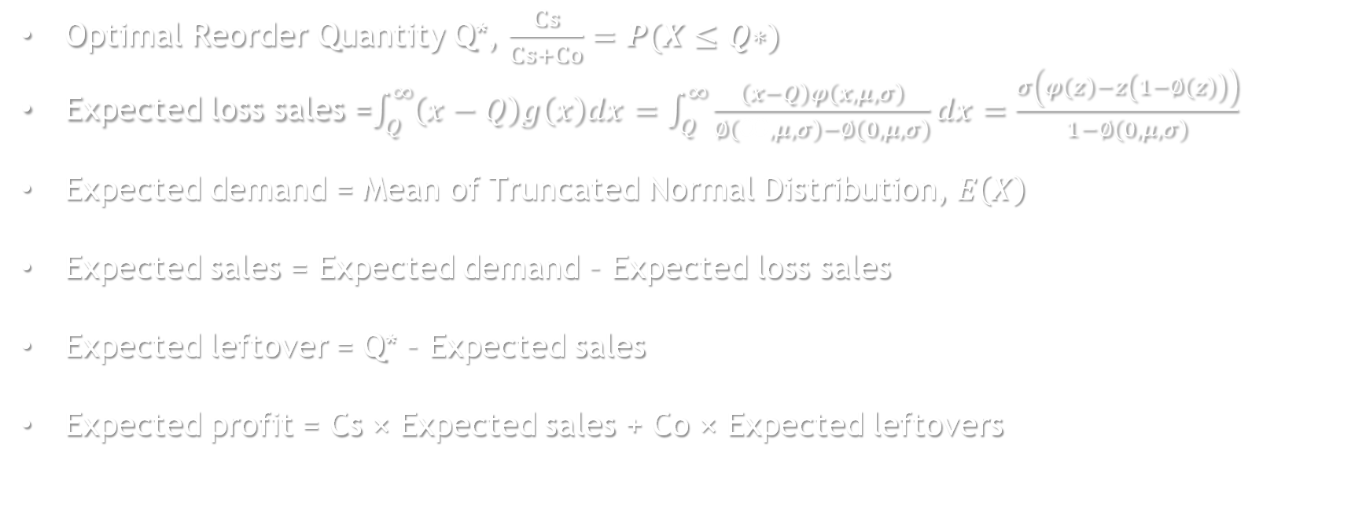

NEWSVENDOR MODEL
Truncated normal pdf : $g\left(x\right)=φ\left(µ,σ,a,b;x\right)=\frac{φ\left(x,μ,σ\right)}{∅\left(b,μ,σ\right)−∅\left(a,μ,σ\right)}$
$if a<x<b;$ where $φ\left(x,μ,σ\right)$ is the underlying general normal pdf
Optimal Reorder Quantity Q*, $\frac{Cs}{Cs+Co}=P(X≤Q\text{∗})$
Expected loss sales =$\int_{Q}^{∞}{\left(x−Q\right)g\left(x\right)dx}=\int_{Q}^{∞}{\frac{\left(x−Q\right)φ\left(x,μ,σ\right)}{∅\left(ꝏ,μ,σ\right)−∅\left(0,μ,σ\right)}dx}=\frac{σ\left(φ\left(z\right)−z\left(1−∅\left(z\right)\right)\right)}{1−∅\left(0,μ,σ\right)}$
Expected demand = Mean of Truncated Normal Distribution, $E\left(X\right)$
Expected sales = Expected demand – Expected loss sales
Expected leftover = Q* – Expected sales
Expected profit = Cs × Expected sales + Co × Expected leftovers
VALUEGREENS.SG
Notes:
https://unsplash.com/photos/GKLIsLZxhj0

Slide 20
NEWSVENDOR MODEL
 | Potatoes (grams cluster) | Broccoli (packets cluster)
Optimal Q* | 523.541 g | 1.695 packets
Profit per day | $ 0.102616571 / day | $ 0.34335416 / day
Total Profit per day = $0.45
VALUEGREENS.SG
Notes:
https://unsplash.com/photos/GKLIsLZxhj0

Slide 21

(Q-r) Model

Slide 22
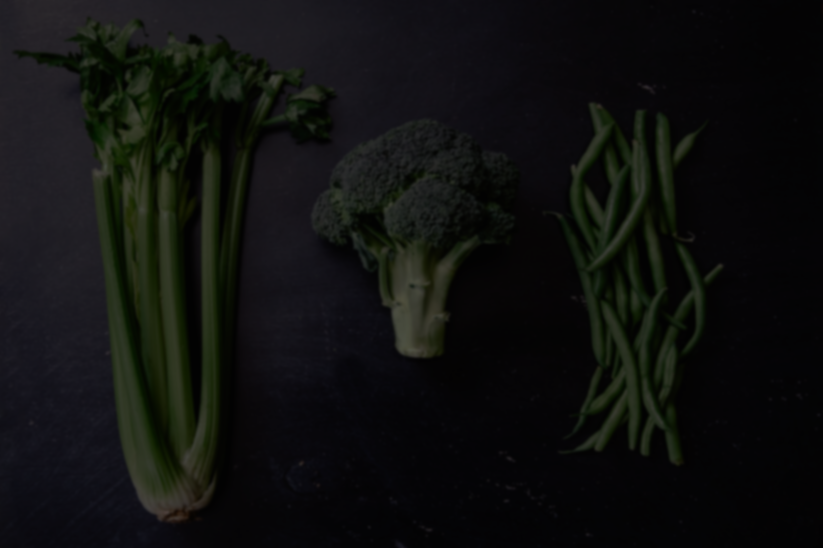
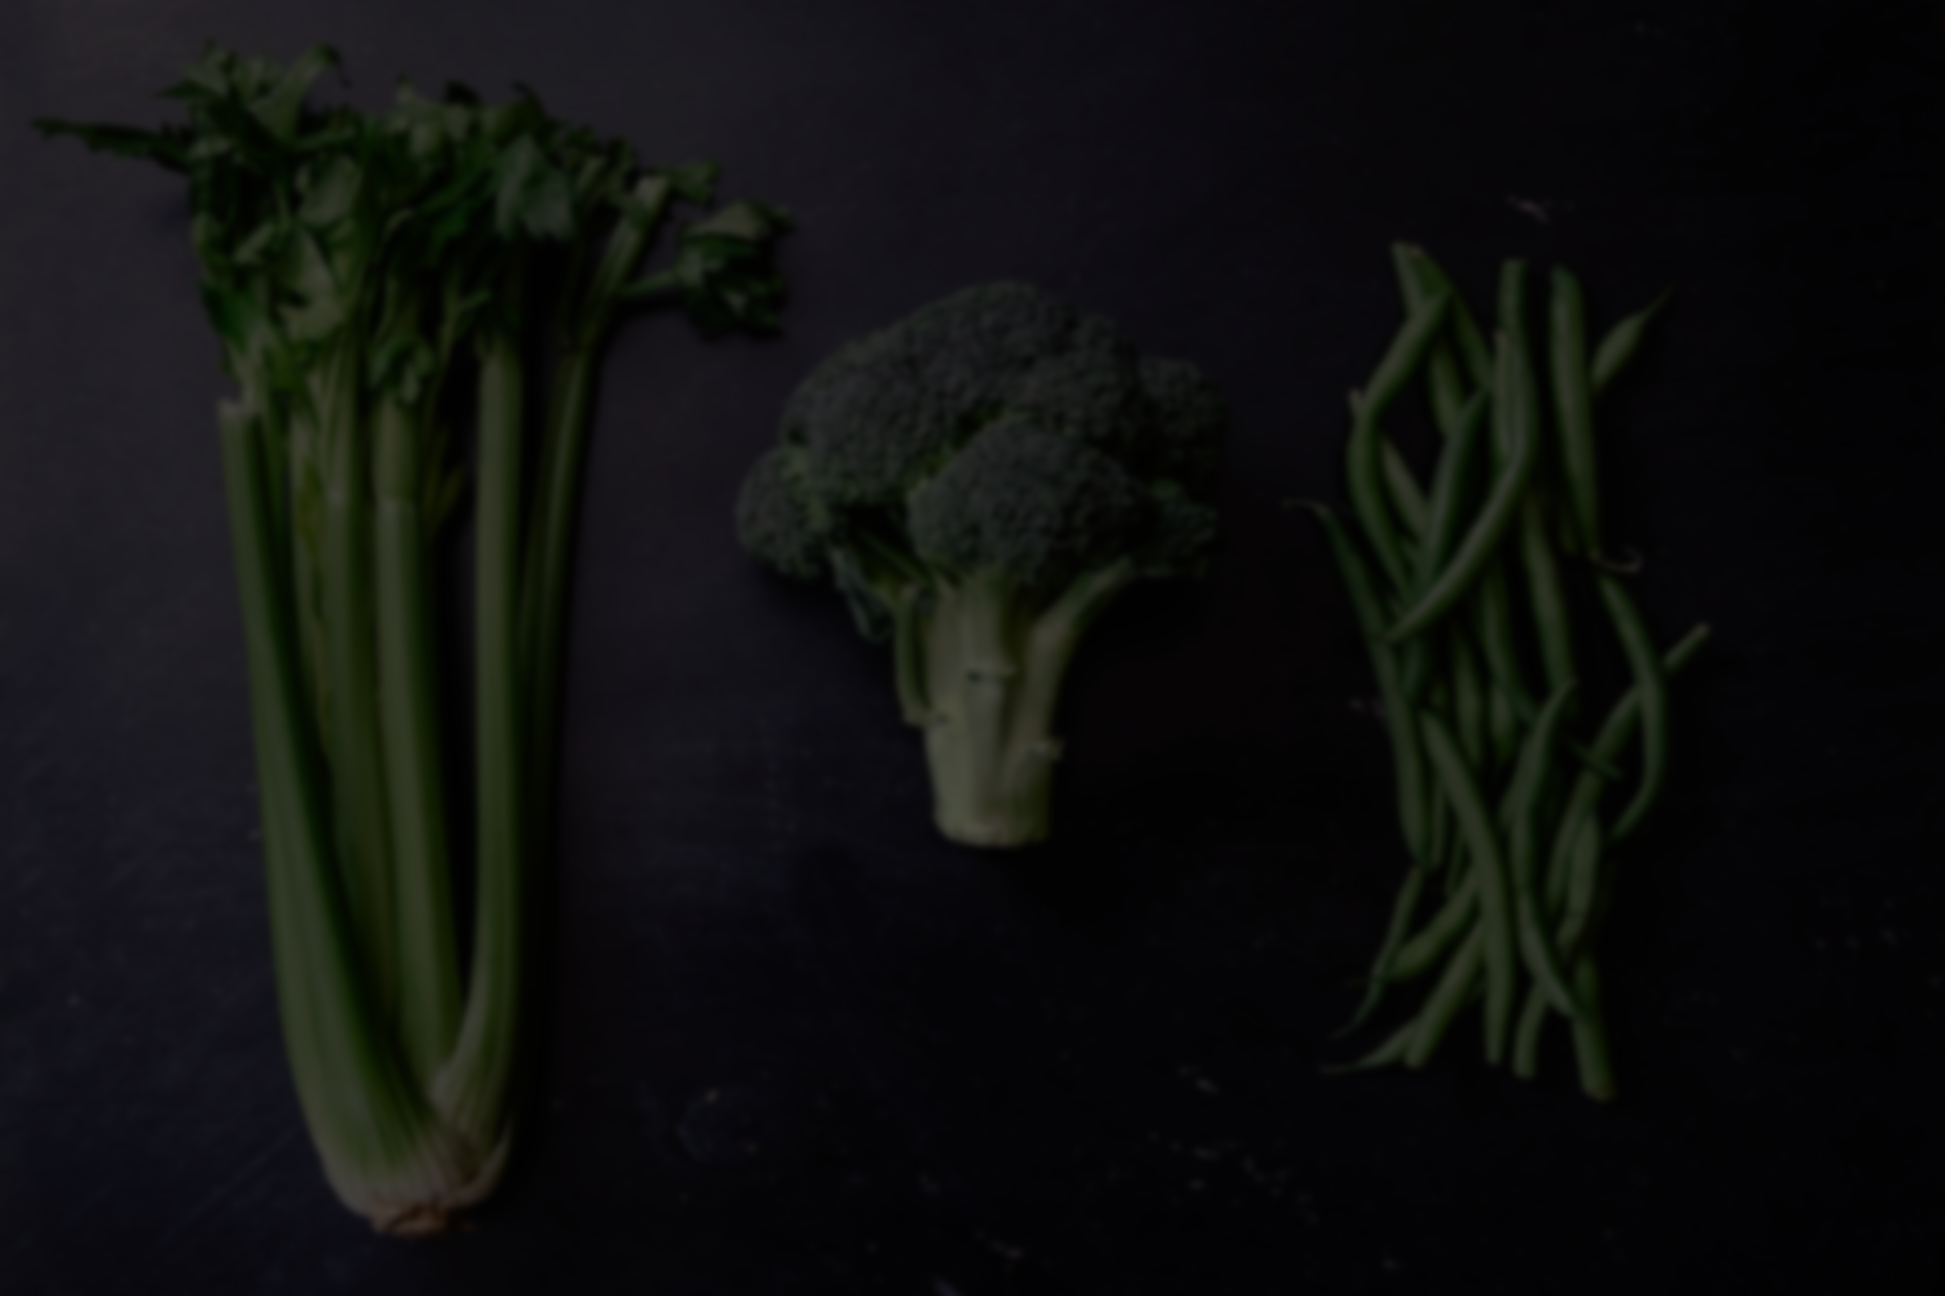
(Q-r) Model
Determine optimal reorder quantity, Q* and reorder point, r*
Trade-off between stockout and holding costs.
Assumptions:
Inventory levels are continuous.
One time decision to order only when reorder point reached.
Vegetables can be kept until the end of their shelf life.
Fixed and known replenishment lead time (1 day)
No interactions between vegetables.
VALUEGREENS.SG
Notes:
https://unsplash.com/photos/GKLIsLZxhj0

Slide 23
(Q-r) Model
 | Potatoes (grams cluster) | Broccoli (packets cluster)
Selling Price | $0.002 / g | $2 / pc
A, Cost Price (80% of selling price) | $0.0016 / g | $1.60 / pc
k (stockout cost) = selling price – cost price | $0.00040 / g | $0.40 / pc
h (holding cost) = 25% x Selling Price | $0.000076 / g | $0.80 / pc
Distribution | Truncated Normal ~(2, 5², 0, ꝏ) | Truncated Normal ~(180, 1900², 0, ꝏ)
D (Mean DD rate) | 1583.278814 g/day | 4.809413519 pc/day
Notes:
https://unsplash.com/photos/GKLIsLZxhj0

Slide 24
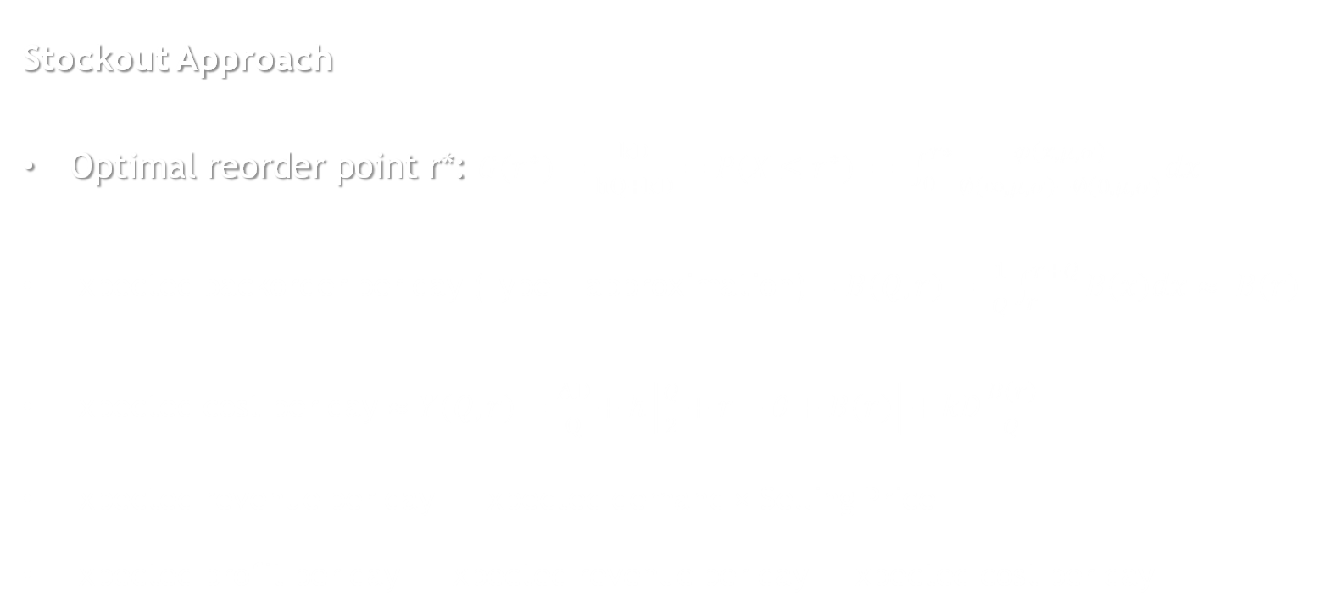
(Q-r) Model
Truncated normal pdf : $g\left(x\right)=φ\left(µ,σ,a,b;x\right)=\frac{φ\left(x,μ,σ\right)}{∅\left(b,μ,σ\right)−∅\left(a,μ,σ\right)}$
Stockout Approach
Optimal reorder point r*: $G\left(r^{∗}\right)=\frac{kD}{hQ+kD}=P\left(X≤r^{∗}\right) = \int_{0}^{r∗}{\frac{φ\left(x,μ,σ\right)}{∅\left(∞,μ,σ\right)−∅\left(0,μ,σ\right)}dx}$
Expected backorder per day (Type II approximation) $=B\left(Q,r\right)= \frac{1}{Q}\int_{r}^{r+Q}{B\left(x\right)dx}≈ B\left(r\right)$
Expected cost per day $≈Y\left(Q,r\right)=\frac{AD}{Q}+h\left[\frac{Q}{2}+r−θ+B\left(r\right)\right]+kD\frac{B\left(r\right)}{Q}$
Expected revenue per day = Expected demand × Selling Price
Expected profit per day = Expected revenue per day – Expected cost per day
VALUEGREENS.SG
Notes:
https://unsplash.com/photos/GKLIsLZxhj0

Slide 25
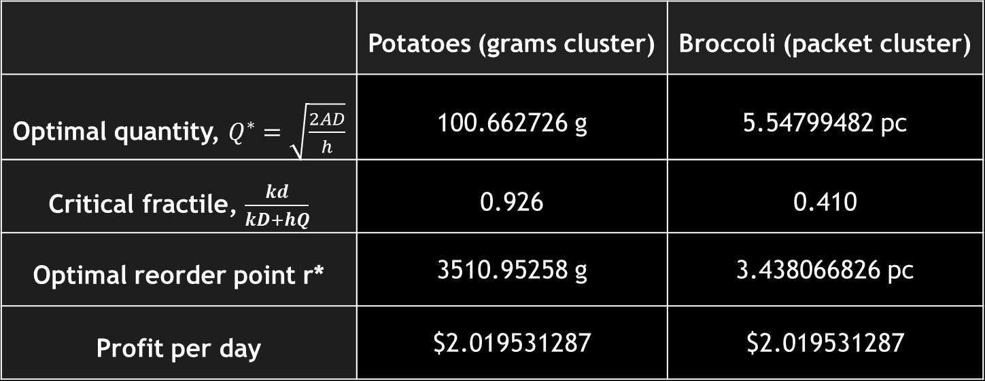
(Q-r) Model
 | Potatoes (grams cluster) | Broccoli (packet cluster)
Optimal quantity, $Q^{∗}=\sqrt{\frac{2AD}{h}}$ | 100.662726 g | 5.54799482 pc
Critical fractile, $\frac{kd}{kD+hQ}$ | 0.926 | 0.410
Optimal reorder point r* | 3510.95258 g | 3.438066826 pc
Profit per day | $2.019531287 | $2.019531287
Total Profit per day = $7.55
VALUEGREENS.SG
Notes:
https://unsplash.com/photos/GKLIsLZxhj0

Slide 26


OVERALL PERFORMANCE
LIMITATIONS

Slide 27

LIMITATIONS
OVERALL PERFORMANCE
 | NewsVendor Model | (Q,r) Model
Total Profit per Day | $0.45 | $7.55
However, freshness of vegetables is compromised.
Demand for vegetables may drop as a result, affecting profits.
VALUEGREENS.SG
Notes:
https://unsplash.com/photos/48nerZQCHgo

Slide 28
OVERALL PERFORMANCE
OTHER LIMITATIONS
Q,r: Continuous review BUT ValueGreens only buy once a day
Newsvendor: Deliveries for supply of vegetables are made in advance of demand BUT ValueGreens receive online orders before buying vegetables from wholesaler.
Reality: we only have data on the online business arm of ValueGreens -> Profits gained are small.
TODAY
TOMORROW
Online Orders
Buy from Wholesaler
Deliver to Customer
VALUEGREENS.SG
Notes:
https://unsplash.com/photos/48nerZQCHgo

Slide 29

FINAL CHOICE
NEWSVENDOR MODEL
 | Potatoes (grams cluster) | Broccoli (packets cluster)
Optimal Q* | 523.541 g ≈ 600g | 1.695 packets ≈ 2 packets
VALUEGREENS.SG
Thank you!
Notes:
https://unsplash.com/photos/48nerZQCHgo

Slide 30

VALUEGREENS.SG
Thank you!

